Slide 1

Solitaire
Alexander Baird

Slide 2
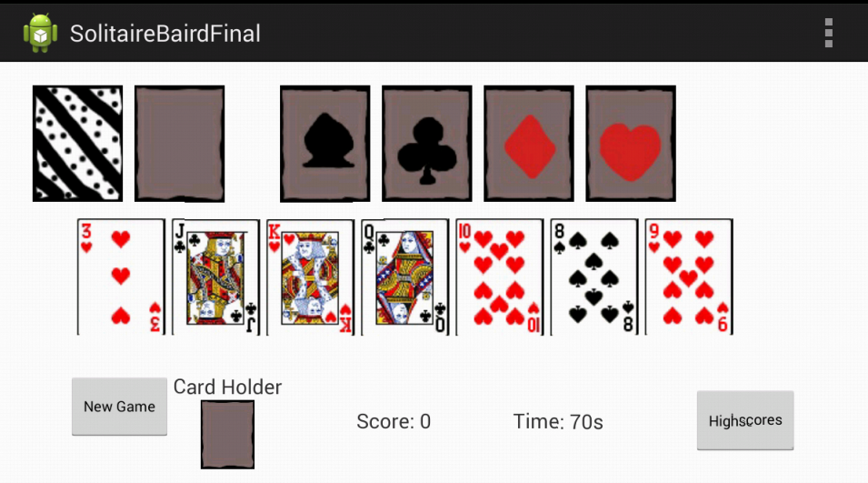
What is my Project
My project is an android version of Solitaire
  Solitaire is a game where your objective is to sort all of the cards into four stacks based on their suit.

Slide 3





My motivation for making this
I want to be a video game designer

Slide 4




My motivation for making this
Solitaire is a game I know very well.

Slide 5
Technology/Implementation Details/ Challenges
Challenges
  Setting up the drag Listeners
    Managed to get it to drag the view, but would send images and cards to oblivion when tried to drop the view.
    In order to support the drag listeners, you have to have version 8 of android or higher.

Slide 6

Technology/Implementation Details/ Challenges
  Handling the screen flip
    At first had not realized that could lock the layout to a particular format (landscape or portrait)

Slide 7
Technology/Implementation Details/ Challenges
Technology/Implimentation
  Due to the attempts at using the drag listeners, the app supports at it's minimum version; version 8.
  It uses clickListeners, ImageViews, TextViews, and Buttons.

Slide 8
Technology/Implementation Details/ Challenges
  It will start a new game everytime you open it, but it will keep track of the high scores and associated names.
  It also passes information between two different activities.

Slide 9
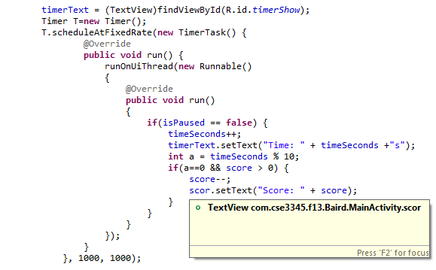
Techniques/Technology/Components that we did not use in class
Timer
  Used when dealing with time
  Can be set for different intervals than seconds

Slide 10
Techniques/Technology/Components that we did not use in class
OnDragListener
  Suppose to handle what happens when you drag a view

Slide 11
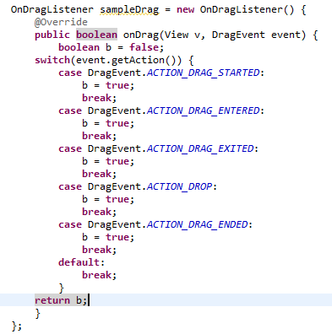
Techniques/Technology/Components that we did not use in class
  DragListeners have a number of events that must be defined within the onDrag

Slide 12
Techniques/Technology/Components that we did not use in class
OnTouchListener
  Handles events when you touch a particular view
  This or OnLongClickListener must be used alongside OnDragListener.

Slide 13
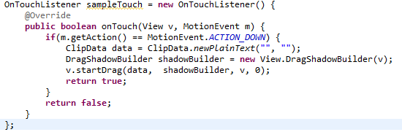
Techniques/Technology/Components that we did not use in class
  In order to have a touch listener prepare things for a drag listener, a ClipData, and a DragShadowBuilder must created, then along with the view and a 0, forwared to the method: startDrag

